Slide 1
Composite Microservice
“Place Order”
These slides are to be used in conjunction with the lab document.

Slide 2
OBJECTIVE
Invoke REST APIs using Python
JSON Web APIs
Implement composite microservice “Place Order”

Slide 3
Remember this?
Mini Case: From Zoko to Amazing Bookstore
Background
Zoko, the retail company that sells books and other items,
…
Amazing Bookstore will be a web-based solution that provides a graphical user interface (UI) for users to browse books and place an order for a book.
...

Slide 4
Remember this?
5. Send the newly created order
{ order }
Shipping Record
Order
2. Send the order information
{cart items}
3. Return the newly created order
{ order }
An explicit (composite) microservice for the entire user scenario
6. Return the created shipping record or error
Place an Order
Activity Log
4. Send the order activity for recording
1. Send the order information
{cart items}
7. Return the created order and shipping record and/or error
3. or 6. If error from any service, activate the error handler
Error
Amazing Bookstore UI
Place an order
‹#›

Slide 5


Reorganising a bit…
Amazing Bookstore UI
Place an order
1. Send order info {cart items}
7. Return created order, shipping record and/or error
Place an Order
If error, activate error handler
2. Send the order info {cart items}
3. Return new order
6. Return new shipping record or error
4. Record new order
5. Send new order
Order
Activity Log
Shipping Record
Error
order
order_items
Notes:
The messages are shortened (when compared with previous slide) to fit into the page.

Slide 6
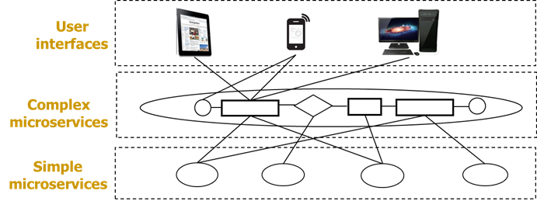
Remember this?

Slide 7
Reorganising...
User Interface
Amazing Bookstore UI
Place an order
Composite (micro)services
Place an Order
Atomic (micro)services
Order
Activity Log
Shipping Record
Error
order
order_items
Notes:
MySQL database is part of the Order microservice while log file is part of the Activity Log.

Slide 8

This lab...
Amazing Bookstore UI
Place an order
Implement this!
Place an Order
Given these
Order
Activity Log
Shipping Record
Error
order
order_items
Print to console
Print to console.
Simulate success or failure
Print to console

Slide 9
Given microservices
JSON Web APIs
Read the code and API documentation
Order
Activity Log
Shipping Record
Error
order.py
shipping_record.py
activity_log.py
error.py
Notes:
API documentation of the microservices can be found in https://drive.google.com/drive/folders/1pMu97ovCRkCXtc-Po6G91U83iHyU6WsM?usp=sharing

Slide 10
shipping_record.py
Quote from the requirements:
… an order should trigger … a shipping record .... If the generation of the shipping record … fails to complete for any reason, an error handling function should be activated...
if “ERROR” in customer_id:
# simulate failure.
else:
# simulate success
Shipping Record
Print to console.
Simulate success or failure

Slide 11
order.py
Order
class Order(db.Model):
__tablename__ = 'order'
…
class Order_Item(db.Model):
__tablename__ = 'order_item'
item_id = db.Column(…)
order_id = db.Column(
db.ForeignKey('order.order_id', …), …)
…
order = db.relationship(
'Order', primaryjoin='Order_Item.order_id == Order.order_id', backref='order_item')
…
order
order_items

Slide 12
Do lab

Slide 13
flask CORS
We need CORS to allow Cross-Origin Resource Sharing. Cross-origin resource sharing (CORS) is a mechanism for integrating applications.
from flask import Flask, request, jsonify
from flask_cors import CORS
from flask_sqlalchemy import SQLAlchemy
from os import environ
app = Flask(__name__)
CORS(app)
This allows our services to have cross-origins enabled, preparing us for a future lab on the bookstore.
Notes:
https://stackoverflow.com/questions/7023052/configure-flask-dev-server-to-be-visible-across-the-network

Slide 14
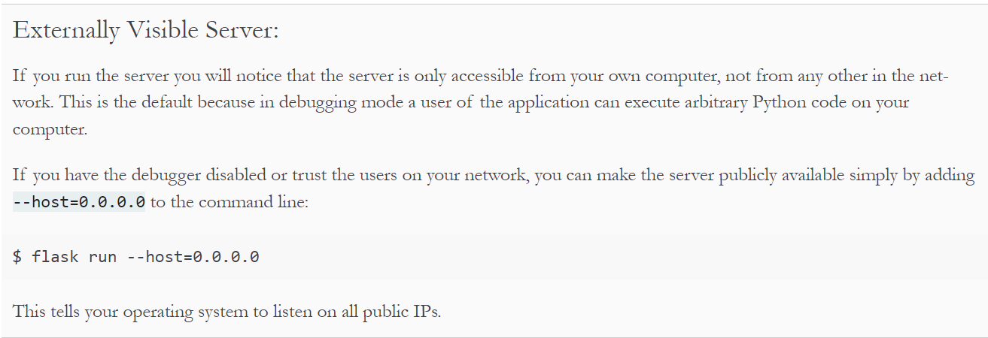
app.run(host='0.0.0.0', …)
For place_order.py, order.py, shipping.py, activity_log.py, error.py
app.run(host="0.0.0.0", port=5100, debug=True)
This is to make the server publicly available
Ref: https://flask.palletsprojects.com/en/3.0.x/quickstart/
Notes:
https://stackoverflow.com/questions/7023052/configure-flask-dev-server-to-be-visible-across-the-network

Slide 15
“Place order - correct inputs” + WAMP stopped
{
"code": 500,
"data": {
"order_result": {
"code": 500,
"message": "An error occurred while creating the order. (mysql.connector.errors.OperationalError) MySQL Connection not available.\n[SQL: INSERT INTO `order` (customer_id, status, created, modified) VALUES (%(customer_id)s, %(status)s, %(created)s, %(modified)s)]\n[parameters: [{'customer_id': 'Apple TAN', 'status': 'NEW'}]]\n(Background on this error at: http://sqlalche.me/e/13/e3q8)"
}
},
"message": "Order creation failure sent for error handling."
}

Slide 16
“Place order - correct inputs” + order.py stopped
{
"code": 500,
"data": {
"order_result": {
"code": 500,
"message": "invocation of service fails: http://localhost:5001/order. HTTPConnectionPool(host='localhost', port=5001): Max retries exceeded with url: /order (Caused by NewConnectionError('<urllib3.connection.HTTPConnection object at 0x0000020171F18460>: Failed to establish a new connection: [WinError 10061] No connection could be made because the target machine actively refused it'))"
}
},
"message": "Order creation failure sent for error handling."
}

Slide 17
“Place order - shipping failure”
{
"code": 400,
"data": {
"order_result": { "code": 201, "data": { … } },
"shipping_result": {
"code": 400, "data": { "order_id": 18 },
"message": "Simulated failure in shipping record creation."
}
},
"message": "Simulated shipping record error sent for error handling."
}

Slide 18
Learning points
Invoke REST APIs in python
JSON Web APIs
Implement composite microservice
Orchestrated architectural pattern

